Slide 1
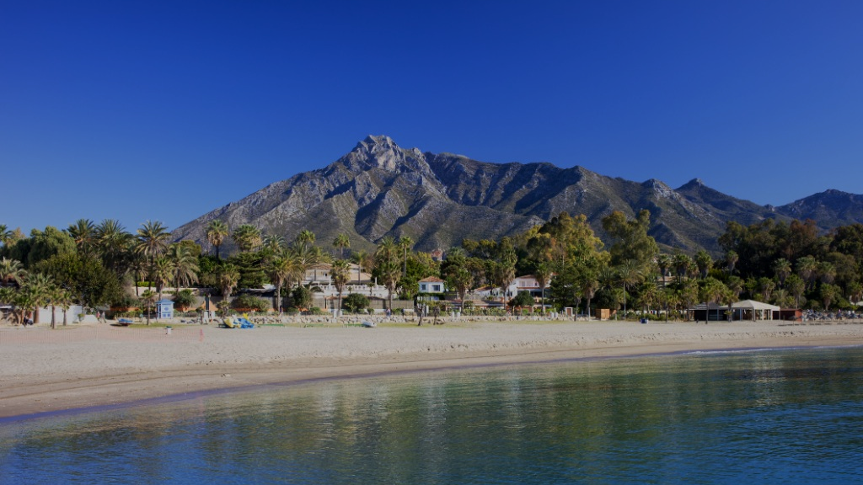
MARBELLA
MEDITERRANEAN BLISS
3 NIGHTS INCENTIVE PROGRAM

Slide 2
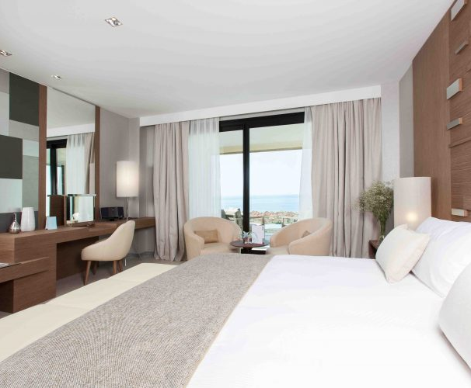
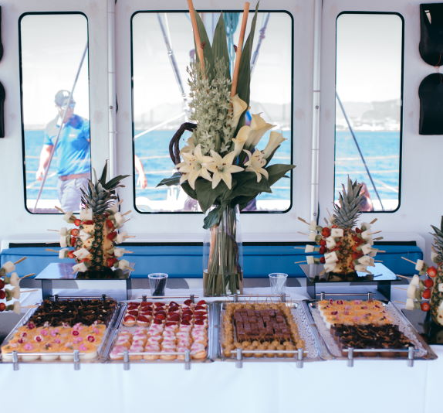
DAY 1: Welcome to Marbella!
Arrival Arrival at Malaga airport & transfer to your Luxury hotel in Marbella. Check in & free time to relax and enjoy the hotel's facilities to unwind from the trip
Early evening, pick up at your hotel & short transfer to Puerto Banus, to embark on a private catamaran and enjoy the sunset from the sea while sipping a glass of wine, beer or soft drink from the open bar. After a stop in high sea for a bath or aquatic activities , a light tapas dinner will be served on board.
Transfer back from Puerto Banus to your hotel.

Slide 3
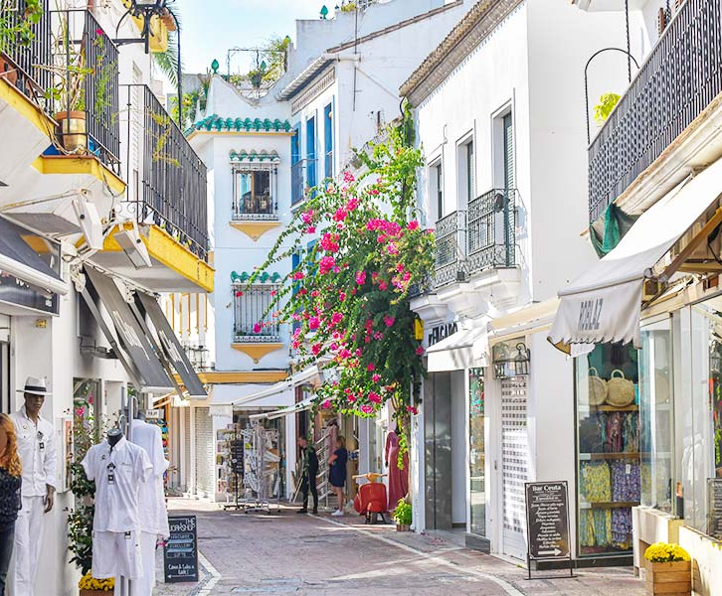
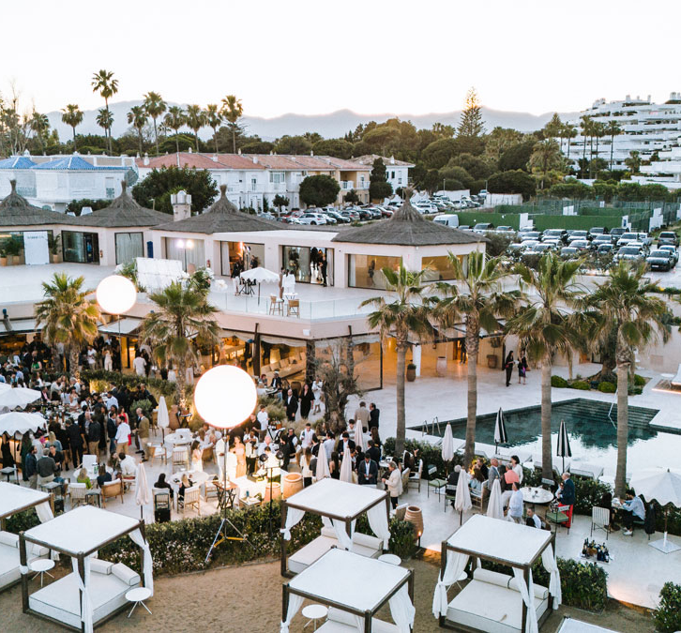
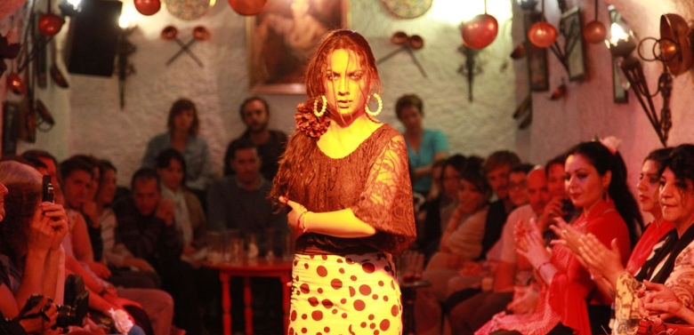
DAY 2: The Mediterranean way
Our day will start with a private guided tour of Marbella Our expert guides will walk us through the charming Old Town , where narrow cobbled streets wind past whitewashed houses adorned with colorful bougainvillea. We will discover hidden squares like Plaza de los Naranjos, lined with lively cafés and historical landmarks, including the 16th-century Town Hall. Along the way, our guides will share fascinating stories of Andalusian history, Moorish influences, and Marbella’s transformation from a small fishing village to a glamorous Mediterranean destination
After this historic inmersion, it's time to tase a bit of glamour! We will take you to one of Marbella most exclusive beach club, where to enjoy in style everything the Mediterranean has to offer: beach, luxury swiming pools, music, sun, cocktails and a delicious Mediterranean lunch in the most elegant yet relaxed atmosphere.
In the evening, step into a world where fire meets soul, and every beat, stomp, and strum ignites the air with raw emotion. This is Andalucía. This is flamenco. As we witness firsthand this celebration of life, passion, and joy, where the rhythm takes over and you can’t help but tap your feet, smile, and feel the undeniable power of Flamenco, we will indulge in a feast of Andalusian flavors, savoring traditional dishes like succulent Iberian ham, gazpacho, and slow-cooked oxtail, perfectly paired with fine Spanish wines

Slide 4
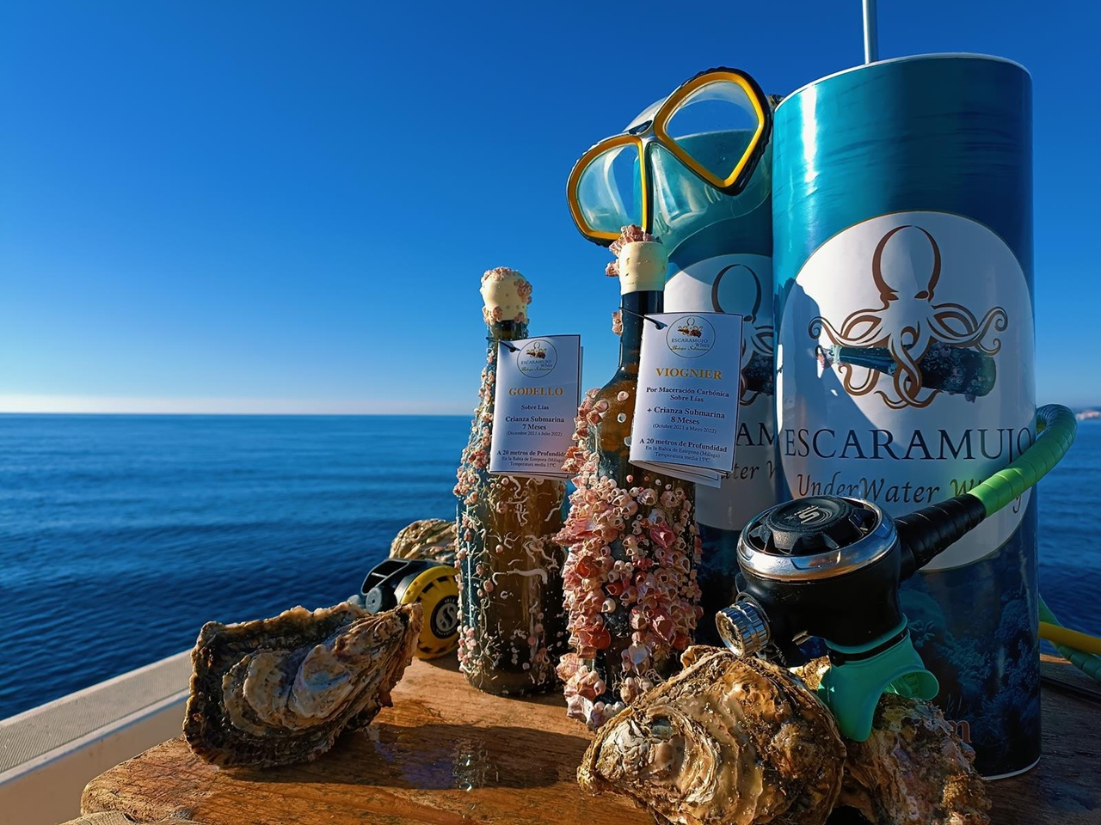
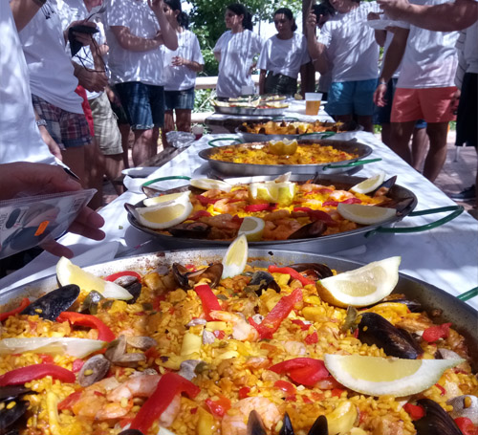
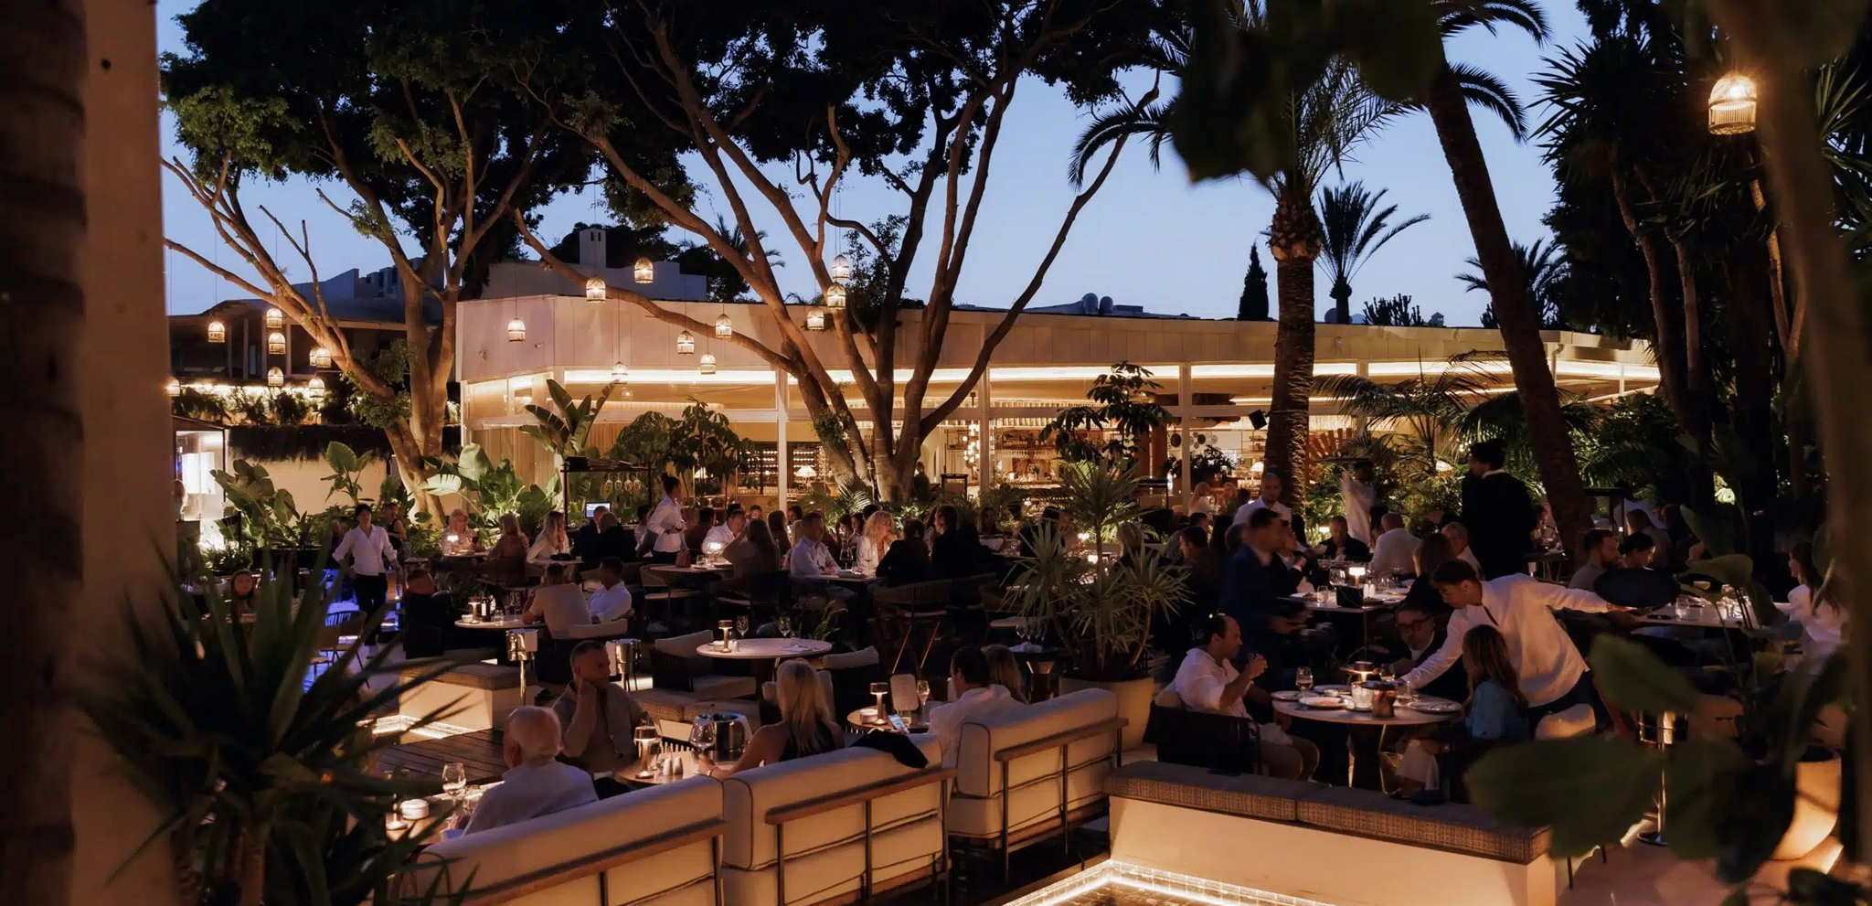
DAY 3: Sip, Sail & Savour
Today, an amazing experience awaits us! It will start with a short transfer to Estepona pier, where we will embark on another yet very unusual a sailing excursion to discover the Escarmujo submarine cellar. After a 30 mn sail , we will reach this amazing submarine cellar and procede with a surprising wine and oyster while the Escarmujo team tells us everything about their disruptive project and many anecdotes about their land and its history.
Within a short drive, we will reach Alabardero Beach club where we will engage in a fun and delicious sangria and paella contest. Get ready to show some cooking skills and try to prepare the best paella, following the instructions of our chef!
We will celebrate our last night in Marbella with a high standing dinner in the current Marbella's place to be,offering a unique blend of modern and traditional elements inspired by Mediterranean life. Drinks & party will follows in the restaurant's club for those who feel like joining the world famous Spanish Fiesta

Slide 5
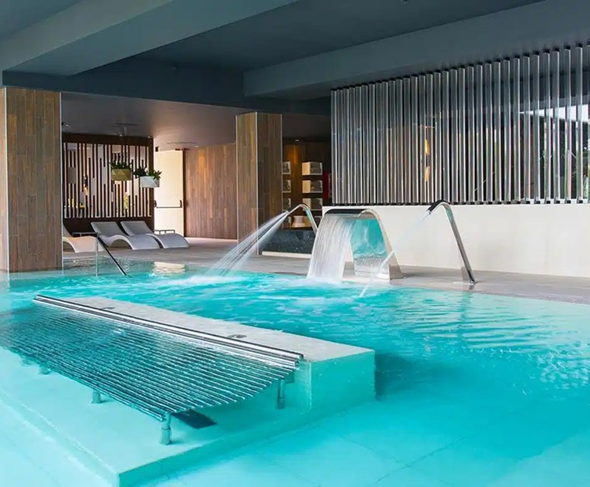
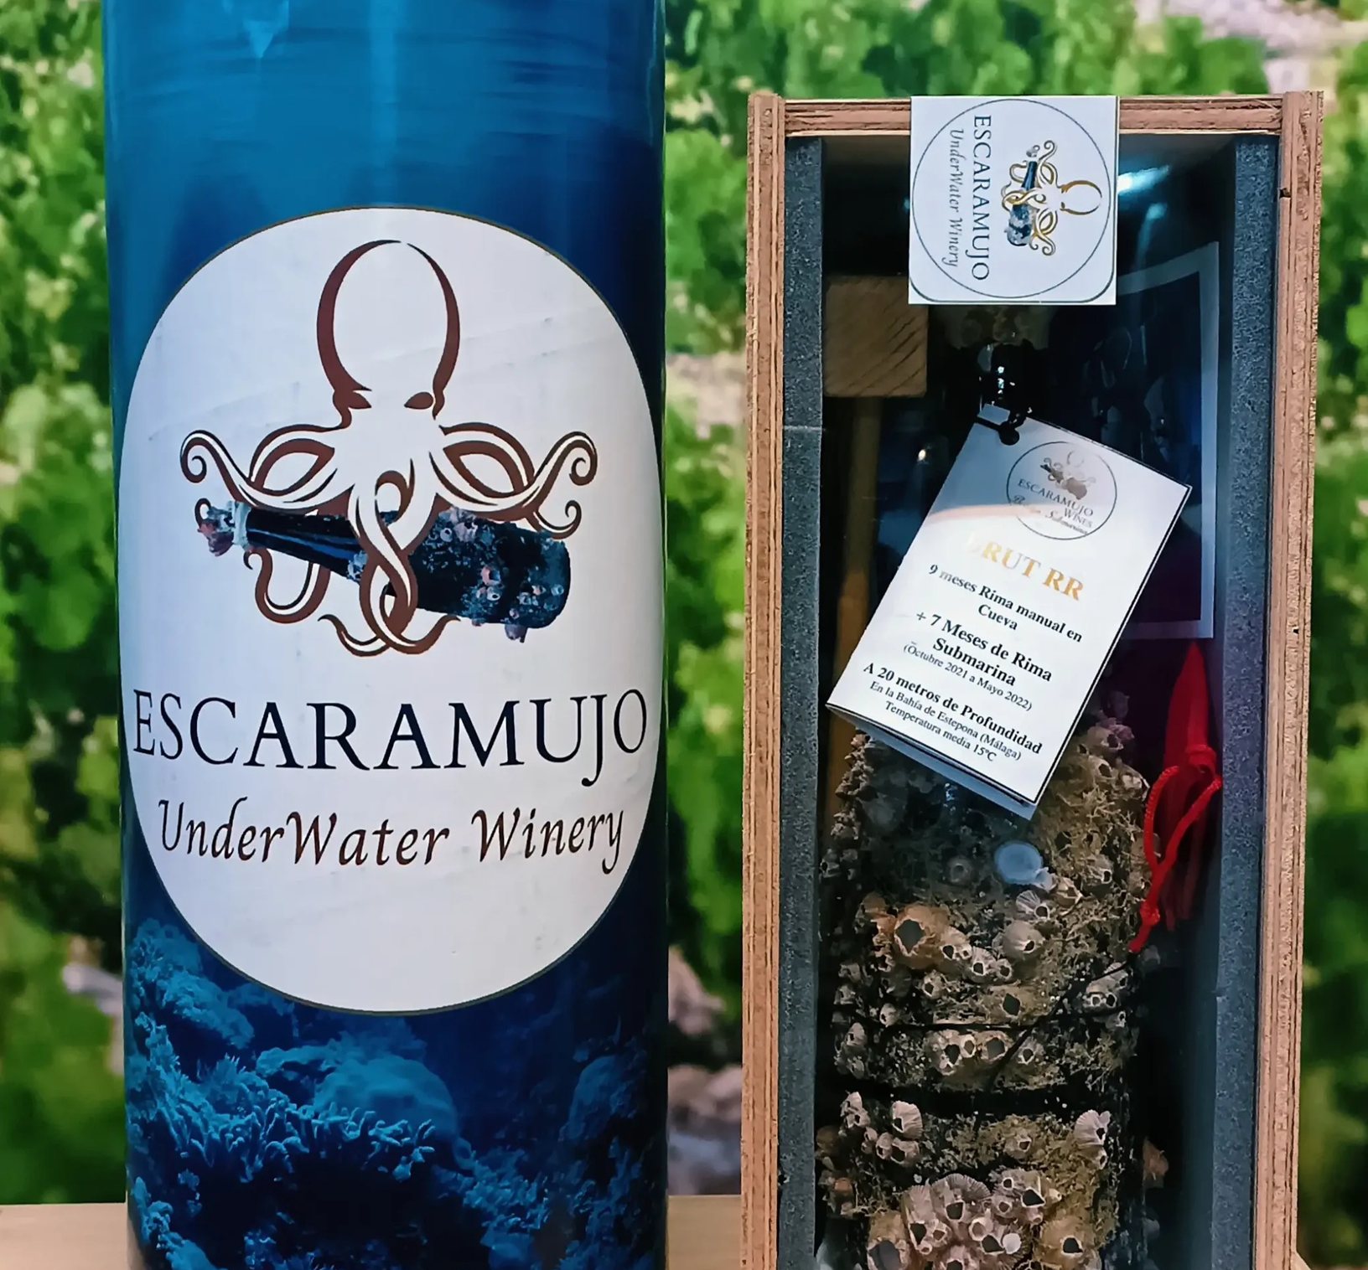
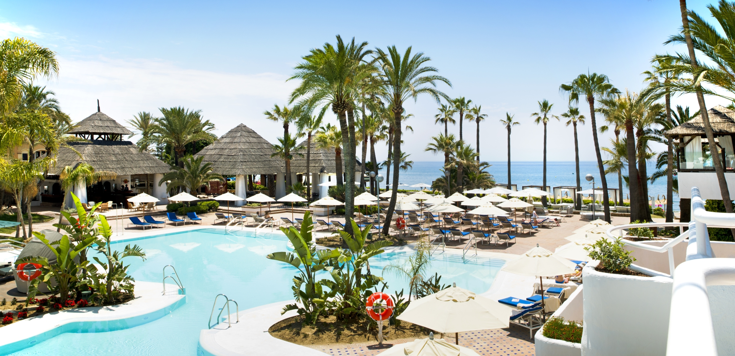
DAY 4: Hasta Pronto!
Breakfast, check out & transfer to the airport
Tell us about your project and we will discuss the best options for your event, according to your budget and special needs.

